Slide 1
Enterprise Architecture Review BOARD
Program Name: Remarketing Decision Modeler

Slide 2
Architecture Review Board (ARB)
Enterprise Architecture
The Architecture Review Board (ARB) ensures all technology solutions align with the organization’s strategic goals, architectural policy frameworks, principles, standards, security policies, and best practices. The ARB evaluates proposed projects and solutions, provides guidance, and ensures consistency across IT initiatives to minimize risks, reduce redundancy, facilitate scalability, re-use, convergence and optimize investments.
The ARB also ensures technology standards are reviewed to remain current and relevant to the organization, as well as assess requests for new technology tools, services, and processes related to the creation, deployment, and management of solutions.
The term Standards is broad in scope and intended to constrain design and development choices and practices to minimize cost, complexity, risk, and improve speed of delivery. It includes but is not limited to design patterns, development and testing practices, tools, platforms, services, and processes used to build, deploy, and manage solutions.
Objectives
Alignment: Ensure IT solutions adhere to enterprise architecture policy, frameworks, goals, principles, standards and business objectives.
Standardization: Promote the use of approved technologies, frameworks, development practices and design patterns; approving any variances with business and architecture justification.
Risk Mitigation: Identify and address technical, security, and compliance risks early in the project lifecycle.
Complexity Mitigation: Identify and minimize complexity in the form of design patterns, duplicate technologies, integrations, and adherence to standards and best practices.
Cost Efficiency: Continuous focus on lifecycle total cost of ownership of systems and solutions, adaptability to changing business needs, and the overall architecture.
Governance: Provide oversight and approval for solution approach to new projects and work requests, changes to architecture standards or variances from standards.
Issue Management: Provide a forum for discussing and resolving architectural issues.
Notes:
Addresses:
Overall project scope and complexity
» Initial architecture design criteria
» Inter- and intra-dependencies of the technology
» Hardware, software, and vendor solutions being considered
» Primary and secondary business functions implemented or impacted by the project
o As-Is Business Processes / Technical Architecture
o To-Be Business Processes / Technical Architecture
» Currently supported business functions and processes
» Opportunities to leverage and reuse existing technology assets
» Other projects with similar scope and characteristics
» Overall risk level

Slide 3
Members
Enterprise Architecture
Name | Focus Area | Roles and Responsibilities
Larry Burgess | Enterprise Architecture | Chair: Responsible for setting the agenda and ensuring meeting and informational material is received by all members prior to meetings. Chairing the committee meetings and ensuring objectives of each meeting are achieved.
Tony Grogan | Infrastructure | Vice chair: Responsible for acting as the chair in the chair’s absence.
Mike Calaway | CISO and Compliance | Secretary: Document meeting minutes and decisions, which includes timely posting of EA artifacts produced by the governing body to the repository.
Bobby Goodwin/Tobin West | Data Management | Voting members: The members that will vote on the projects and standards brought up to the body.
Mike Mckiggan/Deepak Khemchandani/Chris Grimes | Project Management Office
Herb Williams | Solution Delivery
Ryan Miller | Product Management
Parties Requesting Architecture Review
Product Manager or Project Manager | Responsible for ensuring review materials are prepared and distributed to the ARB prior to the meeting. | Collectively the requesting parties represent the stakeholders of the project. At a minimum the prepared materials should address the business problem, proposed solution, related business functions and processes
Product Owner | Responsible for preparing the materials to be reviewed. Product Owner and Architect will collaborate as needed in preparing materials.
Solution Architect/ Domain Architect
Business SME | Provide input related to the business processes and problem statement the project will solve.

Slide 4
Enterprise Architecture
Project/Work Effort : Remarketing – Decision Modeler - Overview
Business Unit | Project Sponsor | Project lead | Estimated Budget | Expected Start Date | Expected Completion Date
Remarketing | Dan Heinrich | Tricia Reed |  | TBD – after discovery final gate review | TDB
Business Alignment
Business Objective | Strategic Alignment | Key Stakeholders | Expected Business Outcomes | Success Metrics
To create a robust, scalable, and intelligent remarketing eco-system that evolves over time to meet business needs. Remarketing Automation and Optimization: For MVP, focus on automation through data integration and initial business rule configuration in the Decision Engine to replace the Market Price in MarketHUB with model driven price Platform Efficiency and Scalability: Leverage Stellantis's familiarity with the FICO platform to ensure efficient and scalable solutions. Standing up FICO system and Connection to Existing SFS Platform: MVP includes standing up the Decision Engine, configuring initial rules, and integrating with EDW and Salesforce for VIN-level price. | To maximize overall net profit by selling the inventory at a best price | Dan Heinrich Rene Abdalah-Herrera Eric Gray |  | Key metrics or performance indicators (KPI's) that will NOT be measured for this project Reason: This is a piece of the larger MarketHub KPI's and success

Slide 5
Enterprise Architecture
Risk and Complexity Assessment
High Risk (PII,PHI,Financial) | Regulated Data (GDPR, HIPAA, PCI-DSS, SOX) | New Technology (Unapproved/vendor-locked solutions) | Major Integration (3+ systems or legacy modernization) | Infrastructure Changes (Cloud migration, data center upgrades)
High (Financial) |  |  | FICO DE, Realtime | FICO Persistence DB
Critical System Impact (Downtime >1 hour or revenue loss risk) | Risk Level Low (Minimal impact) Medium (Controlled risk) High (Critical systems/data) | Complexity Level Simple (Minor enhancements) Moderate (New features) High (Cross-system redesign)
Highly resilient | High | High (Network latency, Multiple systems)
Technical/Infrastructure review
Hosting/Deployment Model (Public Cloud | Private Cloud | On-Premises | Hybrid) | Data Sensitivity & Compliance: (Public | Internal | Confidential | Restricted (PII/PHI)) | Disaster Recovery (RTO/RPO):
FICO (SaaS), Integrations on Azure (Message Bus), Kafka, Redis (cache) | Internal | RTO – Less then 1 hour, RPO - TBD

Slide 6

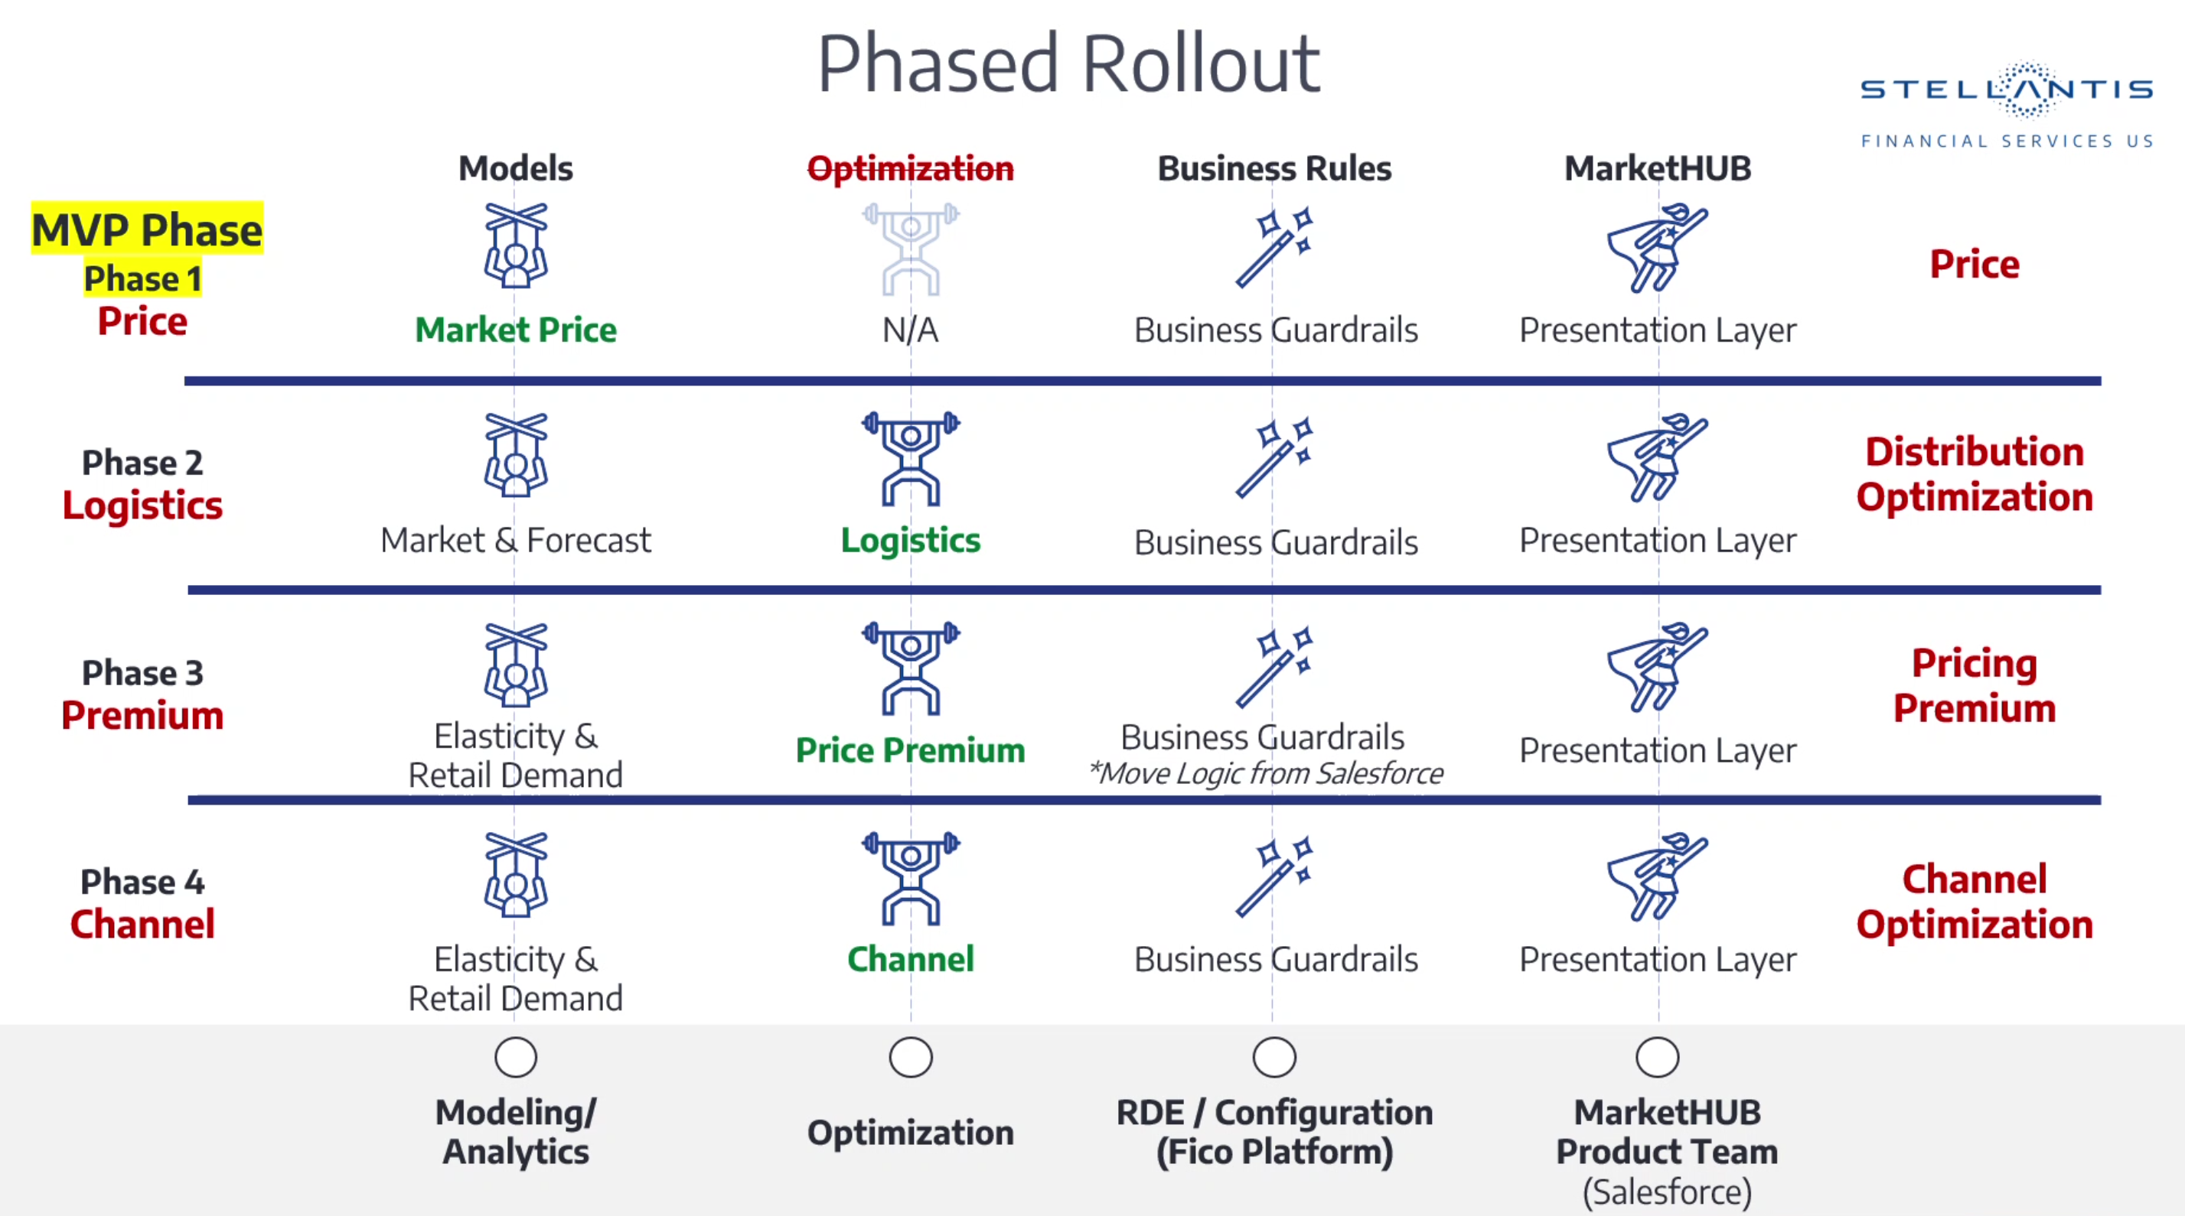



Enterprise Architecture
Program Roadmap
2028

Slide 7
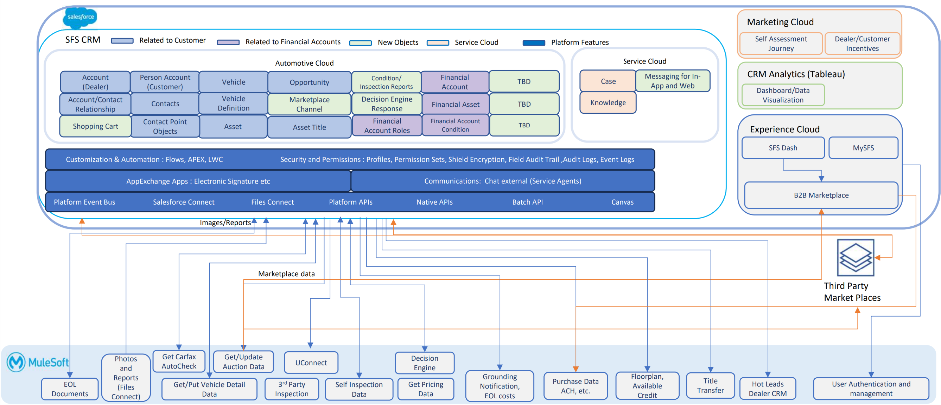


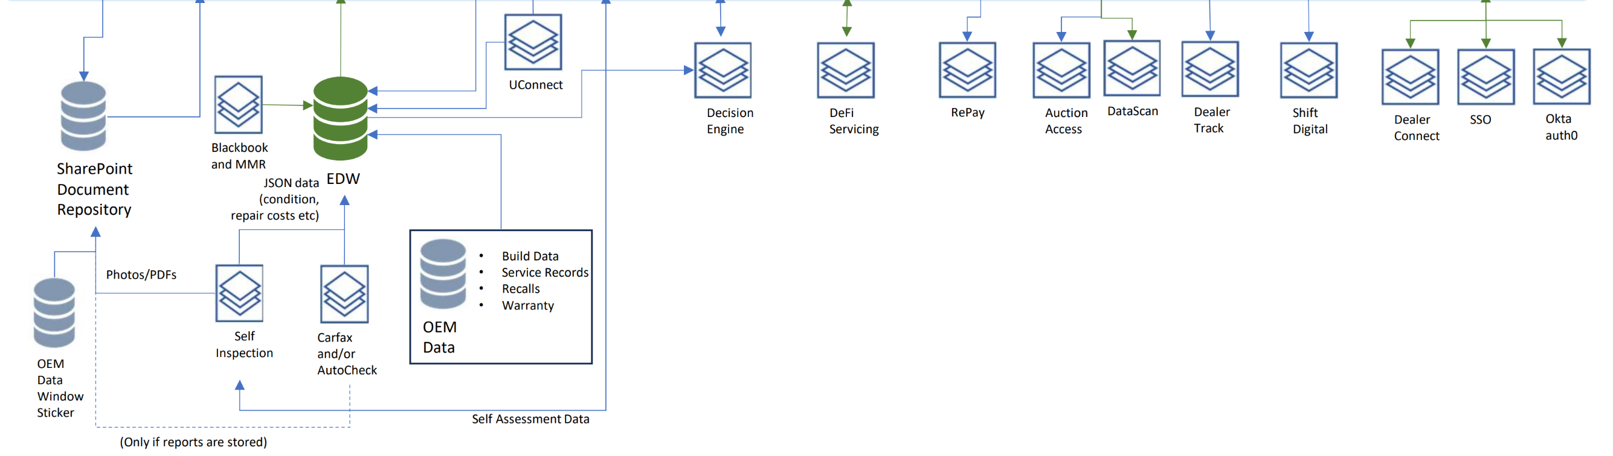


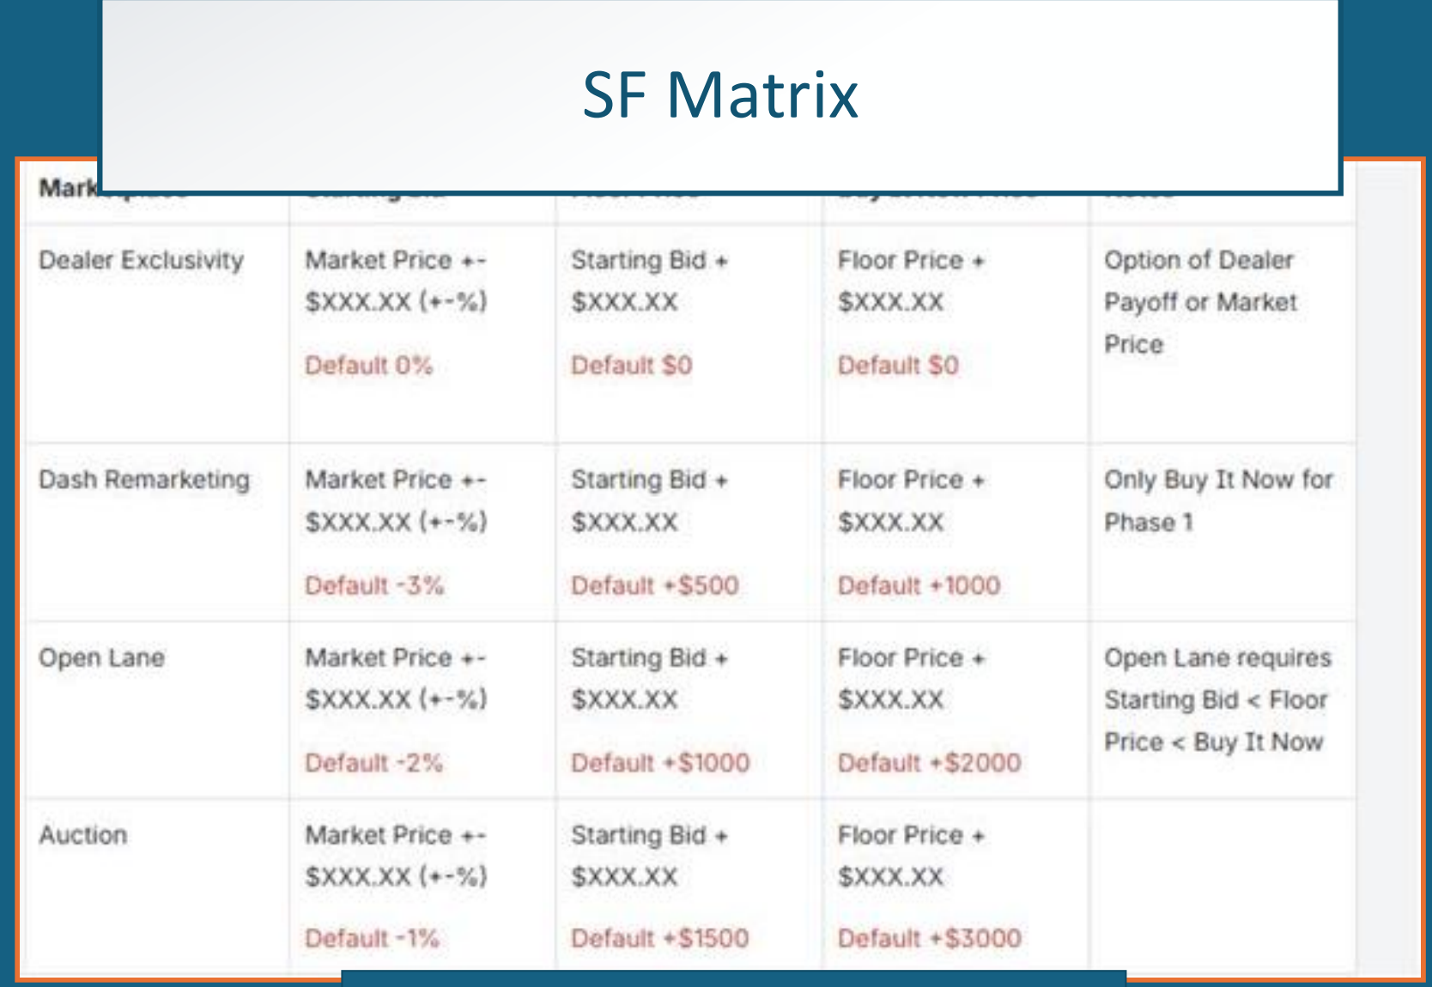

Enterprise Architecture
Current State Architecture – Remarketing Market Hub

Slide 8
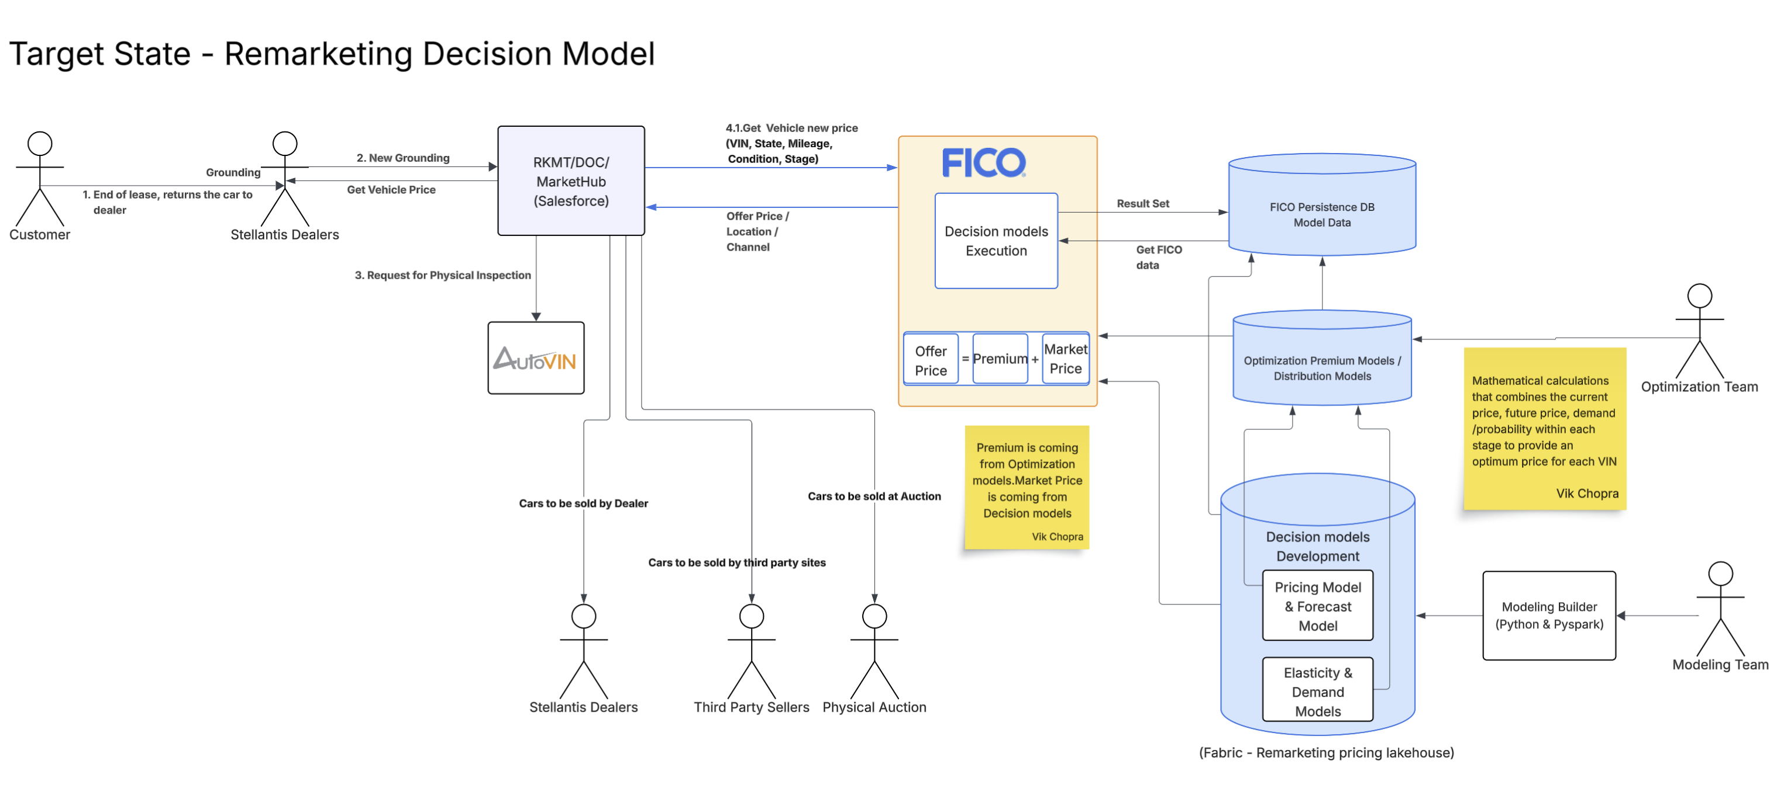
Enterprise Architecture

Slide 9
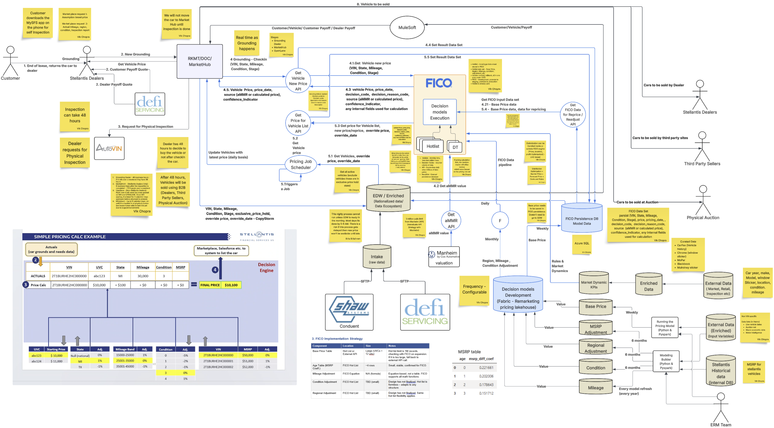
Enterprise Architecture
High level system architecture - Transitional
https://lucid.app/lucidchart/356752bb-4f7e-47fb-9d30-e26d35d1573a/edit?invitationId=inv_1a65fe7c-87ea-41c8-ba25-d9339c2e10b2&page=0_0#

Slide 10
Enterprise Architecture
Capability | Features | Application Name | Application Status
New Grounding | Market-Based Price Display at Vehicle Check-In : MarketHub will display a VIN-level market-based price when a vehicle is checked in. The price will be retrieved from the FICO Decision Engine and presented to the user in near real time to support pricing visibility during the vehicle intake process (Grounding). | Salesforce App – Remarketing MarketHUB
Daily Refresh of Market-Based Price from Decision Engine Calculation (anything already Checked-In, not sold) | Market-Based Price Refresh for Active Vehicles : MarketHub will support refreshed market pricing for vehicles that have been checked in but have not yet been sold. Updated pricing will reflect the most current vehicle attributes, model adjustments and Lifecycle stage information. | Salesforce App – Remarketing MarketHUB
FICO Decision Engine Pricing | FICO Decision Engine Pricing Integration and Fallback Pricing : MarketHub will integrate with the FICO Decision Engine to retrieve market-based pricing using the vehicle VIN. When the FICO decision engine calculated price confidence is low, the aMMR Market Price is returned as a backup to ensure a Market Price is always visible. | FICO Decision Engine
Strategic Alignment – Describe how target architecture aligns to strategy

Slide 11
Enterprise Architecture
Technology Selections Rationale
Technology Capability Needed | Options Considered | Selection | Detail/Rationale | Application Status
Decision Engine |  | FICO | FICO is already used by business in other areas. | Invest

Slide 12
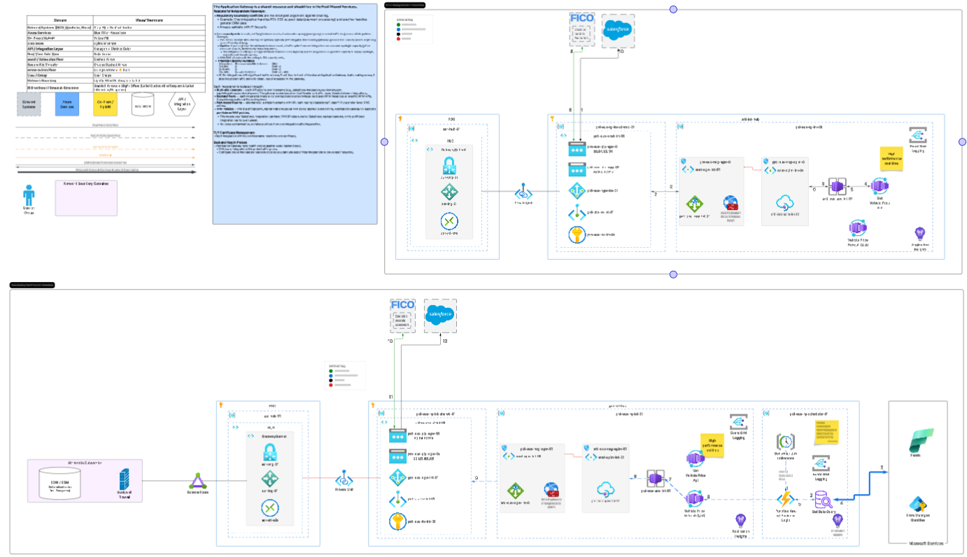
Enterprise Architecture
Deployment Architecture
https://lucid.app/lucidchart/52371bba-2c99-4e09-b52c-77d319d8d381/edit?invitationId=inv_06935f10-495c-4190-b4b9-946ba01faa2a&page=0_0#

Slide 13
Enterprise Architecture
Security and Privacy – Mike Calaway
This will be done when design will be done.

Slide 14
Enterprise Architecture
Nonfunctional requirements
Requirement | Description | Approach
Availability | High availability | FICO and Remarketing/MarketHub Target uptime (99.9%)
Monitoring & Alerting | API & File processing | System failure Alerts, All files, API connections will be monitored. CPU, Compute, Storage thresholds, Network performance will be monitored. If any errors occur during processing, requester will be notified.
Automation | Automated process and operations | No files should be uploaded manually to FICO. Using FICO data pipeline, model data will be loaded to Hotlist tables from SFTP location automatically. Base price model will be stored in FICO persistence database,
Performance | Response time, throughput, latency requirements | When dealer checks-in the vehicle, price will be calculated by FICO Decision Engine and should be displayed in Remarketing app in less than 3 seconds. Redis cache will be used.
Scalability | Systems ability to handle growth | FICO DE is a SAAS solution and scales well with growth. It will use external FICO persistence database to handle model tables that have more than 1 million rows like Base Price table and to store result data set. For integration hub, Azure services will be used.

Slide 15
Enterprise Architecture
Overall Assessment
Chief Architect Assessment: e.g. Proceed Continue to build FICO decision engine to support price calculations | Proceed Date
Modernization | Observations
Cloud: How does this solution align with cloud strategy? AI: How does this solution use AI? | Integration layer will use Azure services. Machine learning and Python will be used to create models.
Reusability/Simplification | Observations
Does the solution adhere to reference architecture? Does the solution architecture promote reuse of components? Does the solution use approved framework/patterns? Does the solution create any Tech Debt? | Yes Yes Yes No
Data Management | Observations
Does this align with enterprise data strategy? | Yes – all vehicle pricing data (FICO persistence DB and Salesforce for any manual overrides) will be passed to EDW for data Analytics.
Security / Risks | Observations
Access and Authorization: What controls are being implemented / already in place?
Digital Experience | Observations
What will be impact to NPS? How does this improve customer experience? | Dealers will get the correct price of the vehicle in near Realtime, increasing SFS profitability. It will also reduce manual overrides.

Slide 17
appendix

Slide 18

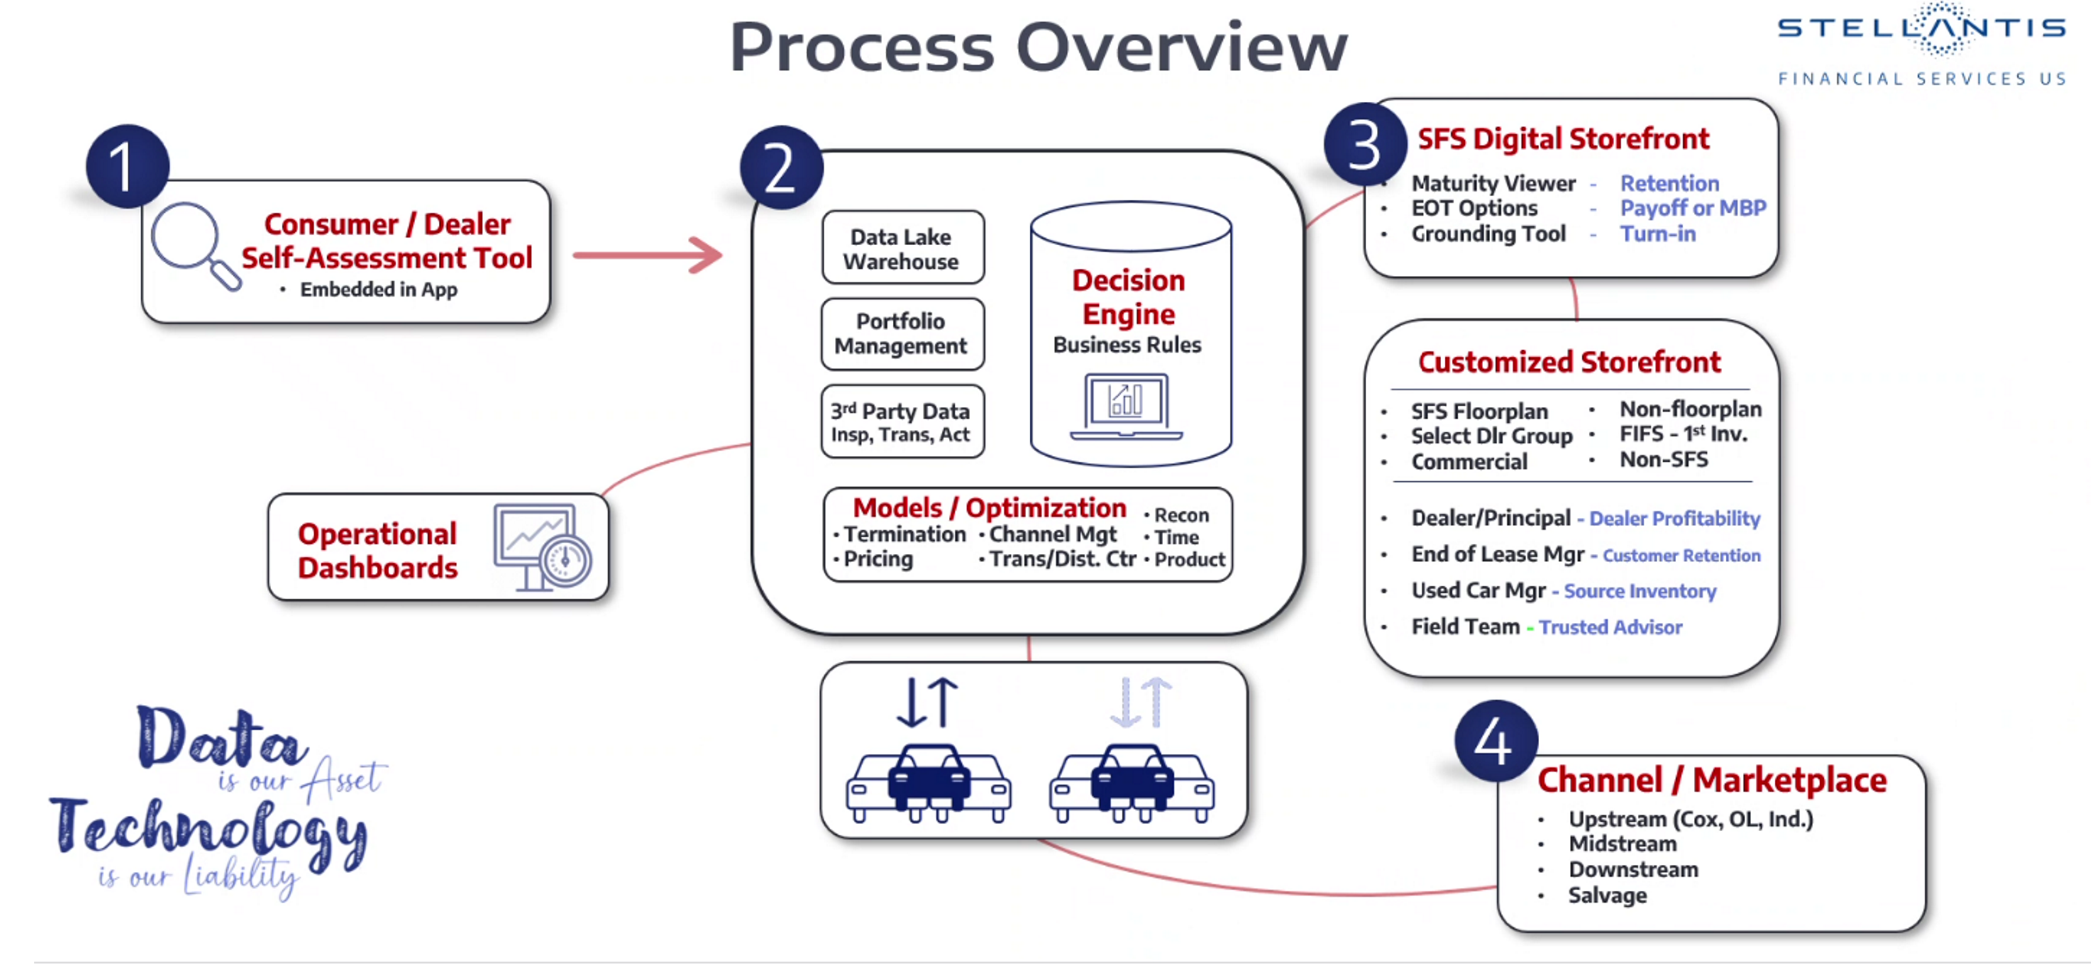

Enterprise Architecture

Slide 19
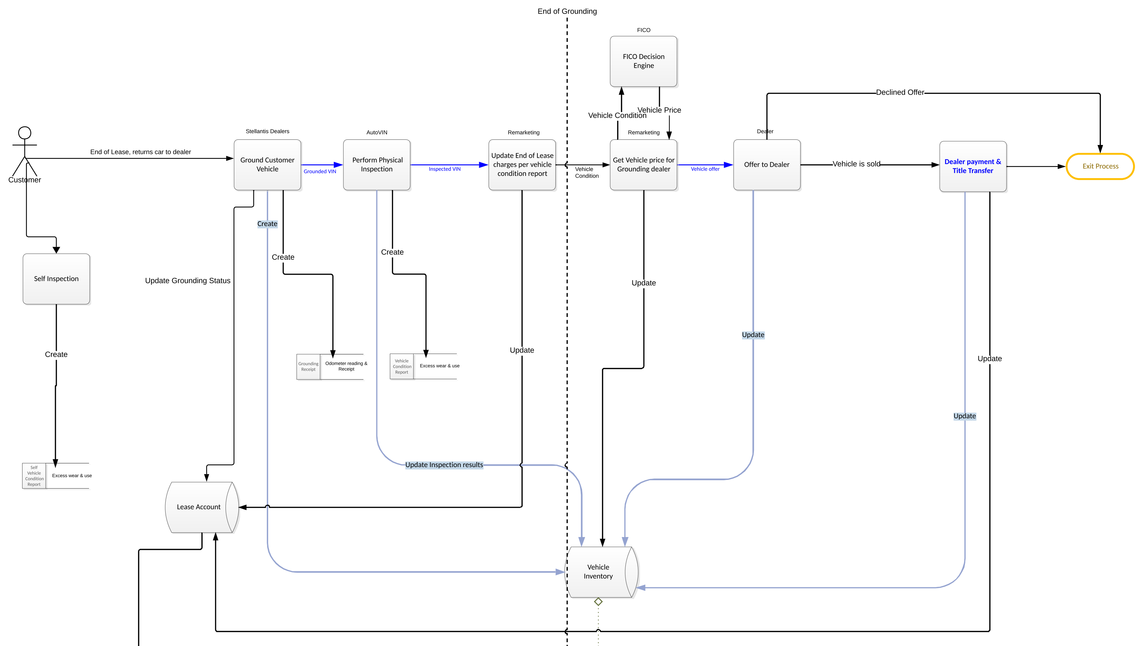
Enterprise Architecture
Target state architecture – System Object Diagram (SOD) – New Grounding

